Slide 1
ViQu - A smart viva and quizzing solution
Submitted by:
101503208 Shivam Sharma, BE Third Year, COE-10
101503211 Shobhit Jain, BE Third Year, COE-10
101503213 Shreya Aggarwal, BE Third Year, COE-10
Capstone Team No. : CPG28
Under the Mentorship of
Dr. Maninder Kaur & Mr. Ashish Girdhar
Assistant Professor Lecturer

Slide 2
Need Analysis
Need to simplify the viva process
Need for a question bank
Need for quicker and easier quiz checking process
Need for a simpler attendance mechanism (optional feature)
Need for facial datasets (optional feature)

Slide 3
Project Overview
A product “ViQu” based on Raspberry Pi 3 along with some sensors will be created, which will be able to conduct vivas, create quizzes and even check them hence, creating a digitized result sheet instantly.
Moreover, a database of MCQs and subjective viva-like questions will be created overtime by the teachers which will help in the future.
Finally, the product ViQu will be able to conduct vivas, mark them, create quizzes, mark them and a fine database of questions will be created for the above.

Slide 4
Objectives
To simplify the viva process
To create a question bank
To simplify the quizzing process
To simply the attendance process (optional)
To improve our skill set

Slide 5
Project Execution Plan (Broad Methodology)
We will be collecting the problems faced in the viva and quiz taking process and will also evaluate how the whole process is undertaken.
Then we will be searching for the perfect solution through research about how these problems can be solved such as the use of Raspberry Pi, NLP, various APIs, etc.
Then we will go on with the proper hardware implementation and side by side create modules for various features.
Now we will run certain tests and try to keep the scenario as real as possible.

Slide 6
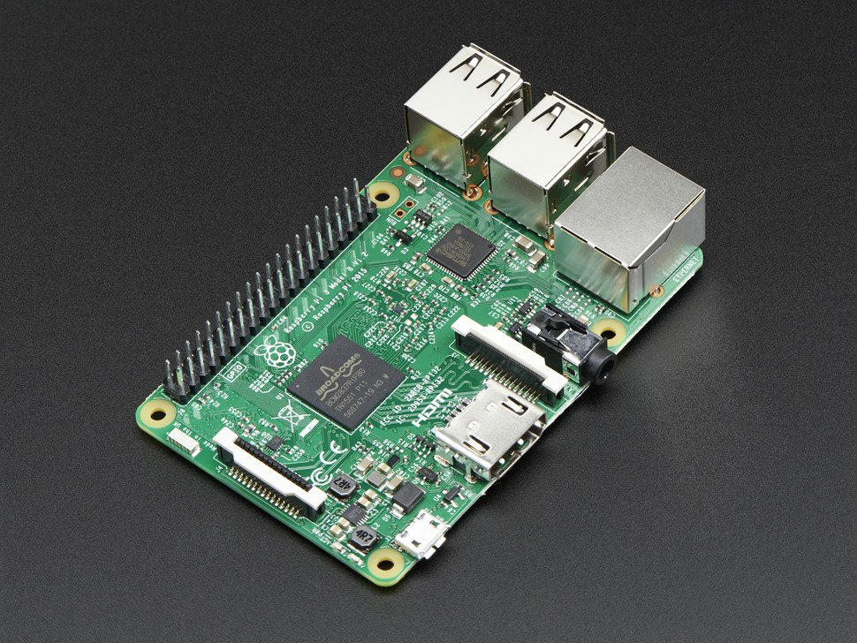
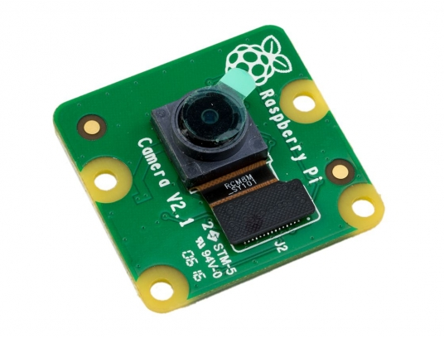
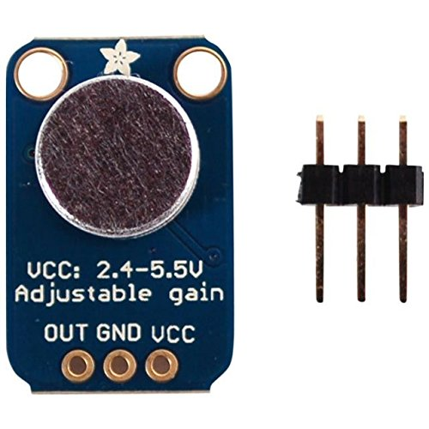
Hardware Requirements
Raspberry Pi 3
Camera
Mic
Speakers
Raspberry Pi box case
Laptop

Slide 7
Software Requirements
Python 2.7
Various Python Libraries such as openCV, pytesseract, etc.
Raspbian OS for Raspberry Pi 3

Slide 8
Outcomes
ViQu will be able to take the viva of a student and evaluate it.
ViQu will also record these viva for any future discrepancies if there are any.
ViQu will also be able to create quizzes (MCQ type) and evaluate them.

Slide 9
Cost Analysis
Raspberry Pi 3 - ₹3000
Camera - ₹900
Mic - ₹300-500
Speakers - ₹300
Total - ₹4500- ₹4700

Slide 10
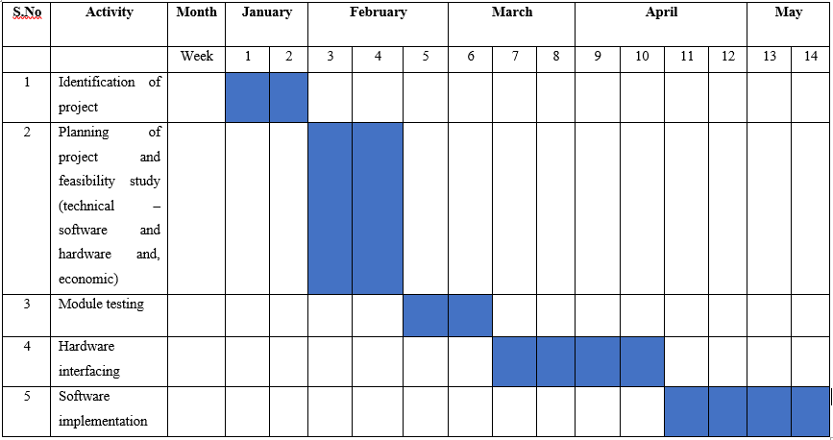
Work Plan

Slide 11
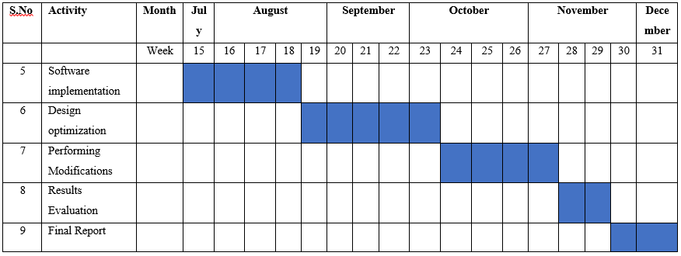

Slide 12
Thank You

